Slide 1


Predicting European Call Option Pricing using Machine Learning Models
Dan (Emily) Luo
Notes:
Hi, everyone. Today, we are going to present our project on predicting European call option pricing using machine learning models. Our group 23 consists of Helen, Crystal, Alice, Angela, Emily, and Elena. We are excited to share our findings with you and discuss the insights we have gained through this project.

Slide 2

Agenda
1
Introduction
2
Data Exploration & Cleaning
3
Model Exploration – Classification
4
Model Exploration – Regression
5
Conclusion
5
Notes:
In this presentation, we will cover six main topics including an introduction, data exploration and cleaning process, classification models, regression models, and conclusion.

Slide 3

1/6
/5
Introduction
Notes:
Now let’s move on to the introduction part

Slide 4
1
Introduction
Introduction
Training models to examine European call option pricing data on the S&P 500
Build several machine learning models to perform our task:
Multiple Linear Regression, Logistic Regression, LDA, KNN, Decision Trees, Random Forest, Boosting
Regression and Classification
Black-Scholes formula
An important tool for valuing European options
Takes into account several key variables, including the current price of the underlying asset, the option's strike price, the time until expiration, the risk-free interest rate, and the expected volatility of the underlying asset
Notes:
We aim to value European call options using machine learning models, instead of relying solely on the Black-Scholes formula. Our goal is to create accurate regression and classification models to predict option values and determine whether the formula over or underestimates the current value. We will test various methods and apply the most effective model to a test dataset, making predictions.

Slide 5
1
Business Understanding
Interpretation is more important than prediction accuracy
According to guest speaker YiYue
Most of the models are not that accurate for predicting the stock market
we use models to analyse and learn the history
In this case, our interpretation is more important than prediction accuracy
Machine Learning Models might outperform Black-Scholes
Black-Scholes Formula Assumptions:
Lognormal distribution of prices
Constant volatility
Continuous price movement
Machine Learning Models:
Non-linearity
Incorporating additional factors
Adaptability
VS.
Notes:
YiYue emphasized that models are not highly accurate when it comes to predicting the stock market. Their primary purpose is to learn from historical data, and interpretation is more crucial than accuracy. Second, machine learning models can outperform the Black-Scholes formula, including non-linearity, adaptability, and the ability to incorporate additional factors, making them more efficient for analyzing the stock market.
<Transition to Helen>
<Script 总结，只做了一个point，可自行总结加点>
Machine Learning Model vs. Black-Scholes:
Black-Scholes posits that instruments, such as stock shares or futures contracts, will have a lognormal distribution of prices following a random walk with constant drift and volatility.
→ Not always be the case in reality. Machine learning models can learn from more complex and diverse data sets, including non-normal distributions. Constant volatility over time also not the case in real-world markets. Machine learning models can capture changes in volatility over time and incorporate them into their predictions.
<参考 from chat GPT>
- VERSION1 (Angela发在群里的截图）
There are several reasons why machine learning models might outperform the Black-Scholes model in predicting option values:
Black-Scholes assumes that stock prices follow a log-normal distribution, which may not always be the case in reality. Machine learning models can learn from more complex and diverse data sets, including non-normal distributions.
Black-Scholes assumes that volatility is constant over time, which is often not the case in real-world markets. Machine learning models can capture changes in volatility over time and incorporate them into their predictions.
Black-Scholes assumes that the underlying asset has continuous price movements,which is not always true in practice. Machine learning models can handle more complex price movements, such as jumps or other non-continuous changes.
Machine learning models can take into account a broader range of market factors, such as macroeconomic indicators, news sentiment, and other financial data that may impact option values.
Overall, machine learning models have the potential to incorporate more complex and diverse data sets, capture more realistic market dynamics, and ultimately produce more accurate predictions of option values than the Black-Scholes model.
- VERSION 2 （和上面理由差不多，可以相互结合）
There are several reasons why machine learning models might outperform the Black-Scholes model in terms of predicting option values:
Non-linearity: Machine learning models are capable of modeling non-linear relationships between the input variables and output variables, while the Black-Scholes model assumes that the relationship between the variables is linear.
More data: Machine learning models can benefit from a larger amount of data, while the Black-Scholes model requires only a limited amount of data.
Incorporating additional factors: Machine learning models can incorporate additional factors that affect the option value, such as changes in market sentiment or news events, while the Black-Scholes model assumes that market conditions are constant.
Adaptability: Machine learning models can adapt to changing market conditions and adjust their predictions accordingly, while the Black-Scholes model remains static.
Overall, machine learning models have the potential to provide more accurate predictions of option values due to their ability to model complex relationships and incorporate additional factors. However, it is important to note that the Black-Scholes model has been a cornerstone of financial modeling for decades and still has its place in option valuation.

Slide 6
2/6
Data Exploration & Cleaning
Notes:
Business understanding (3) & Data Cleaning - Helen 2’00

Slide 7
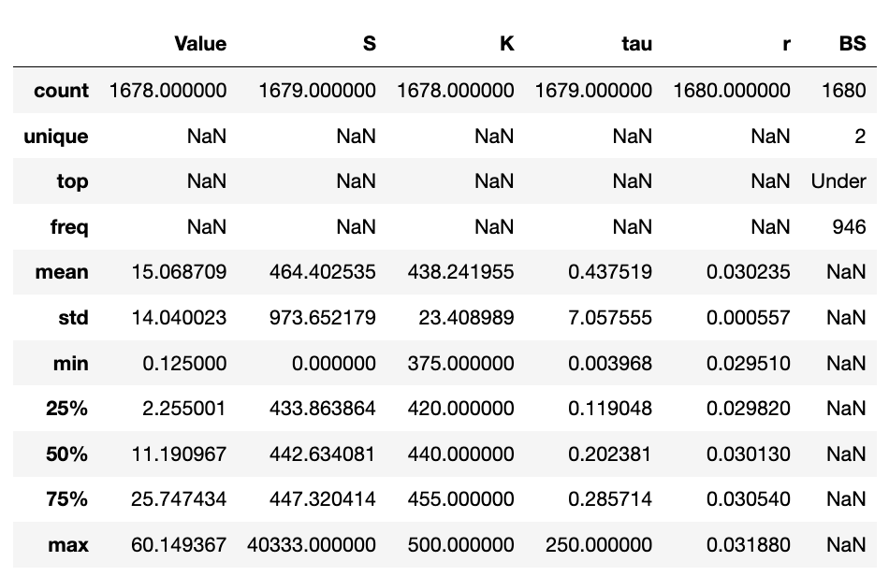
2
Data Exploration & Cleaning
Quick Look in option_train dataset
Value (C): Current option value
S: Current asset value
K: Strike price of option
r: Annual interest rate
tau: Time to maturity (in years)
BS: Use the Black-Scholes formula to get C_pred.
Over: C_pred - C > 0 → Overestimated
Under: C_pred - C < 0 → Underestimated
Original Train Data:1680 rows × 6 columns
Notes:
Thanks Elena.
Now let’s take a quick look to our option_train dataset. There are 1680 [one thousand and sixty-eight hundreds] rows and 6 columns in the dataset.
The first 5 columns (Value, S, K, r, tau) are all numeric variables and BS is the categorical variable. Using Black-Scholes to predict the option value, we used “over” to represent the overestimated prediction and use “under” to represent the underestimated prediction.
Variable selection is not necessary in this case and all four predicted variables should be included in our prediction because they are all critical factors that affect the option value.
As you can see the descriptive statistics on the right, there are some columns contains the missing values. We also noticed that there are erroneous values in some fields. So now let’s take a closer look.

Slide 8
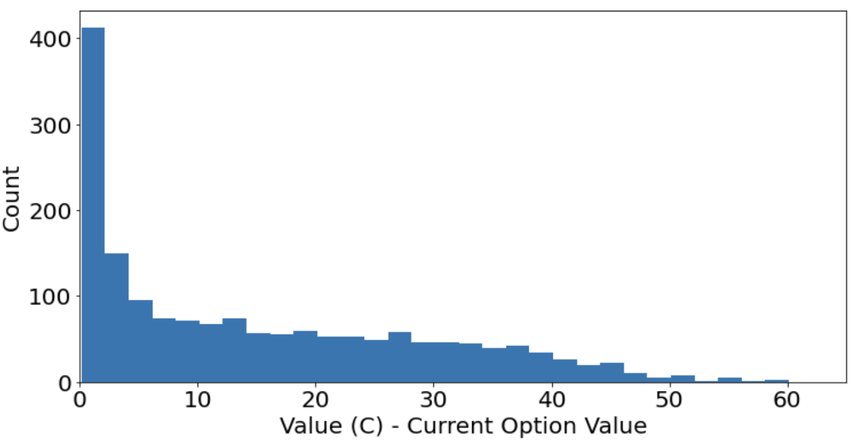
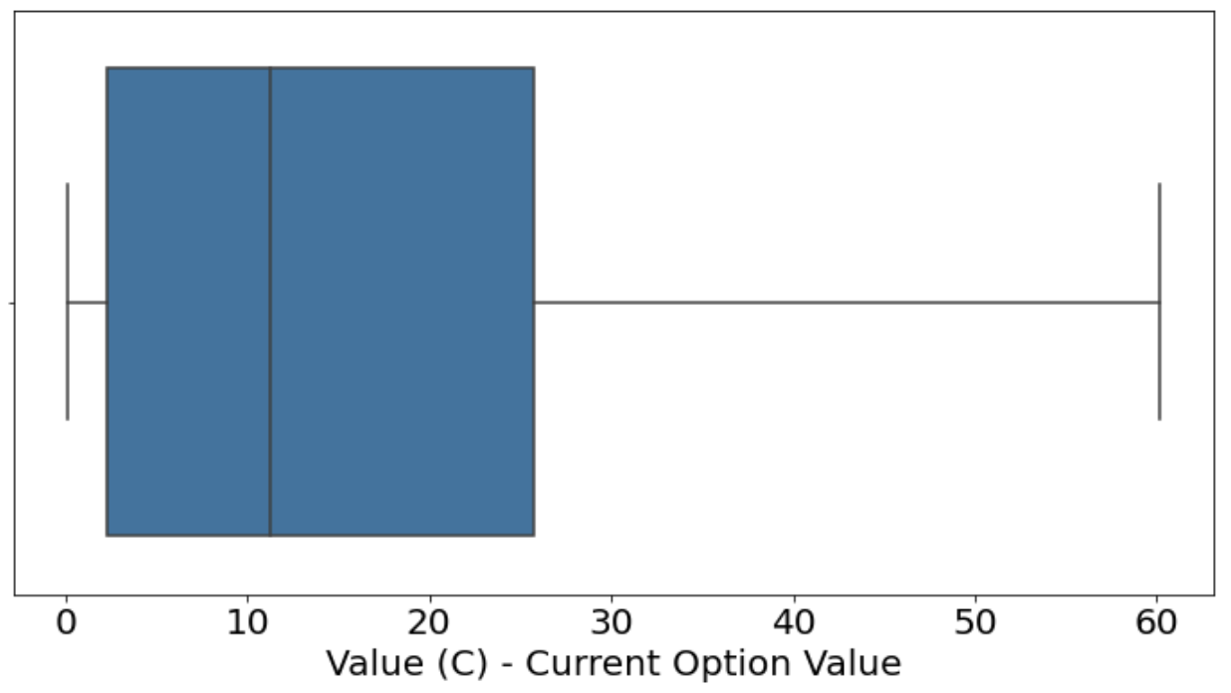
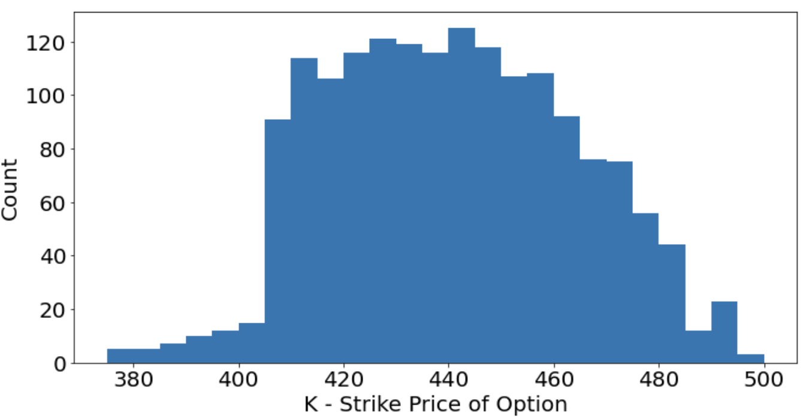
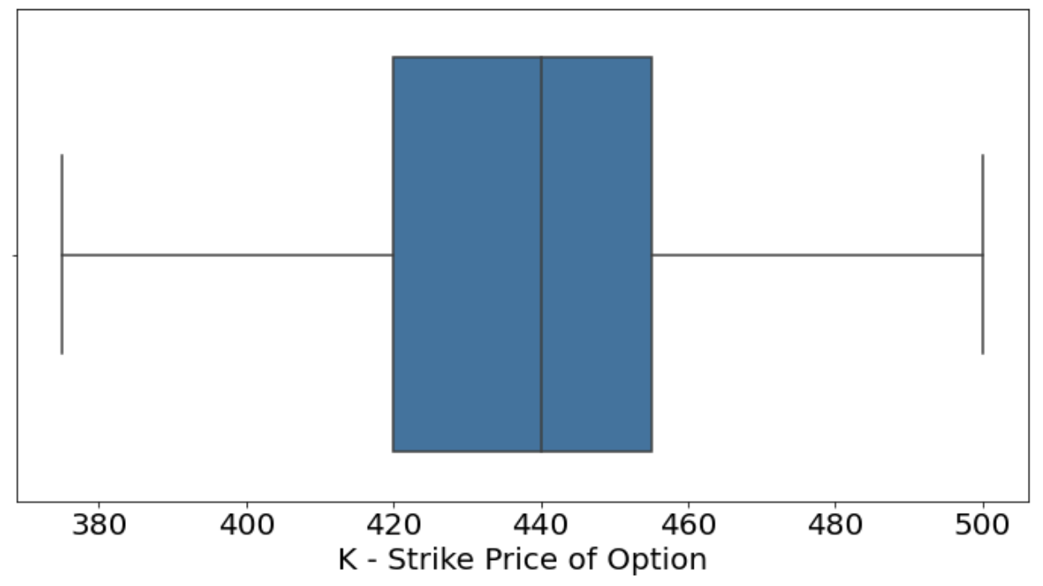
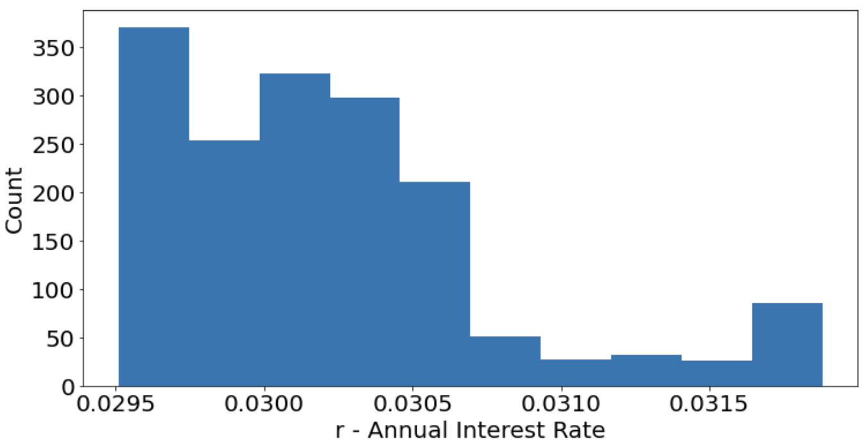
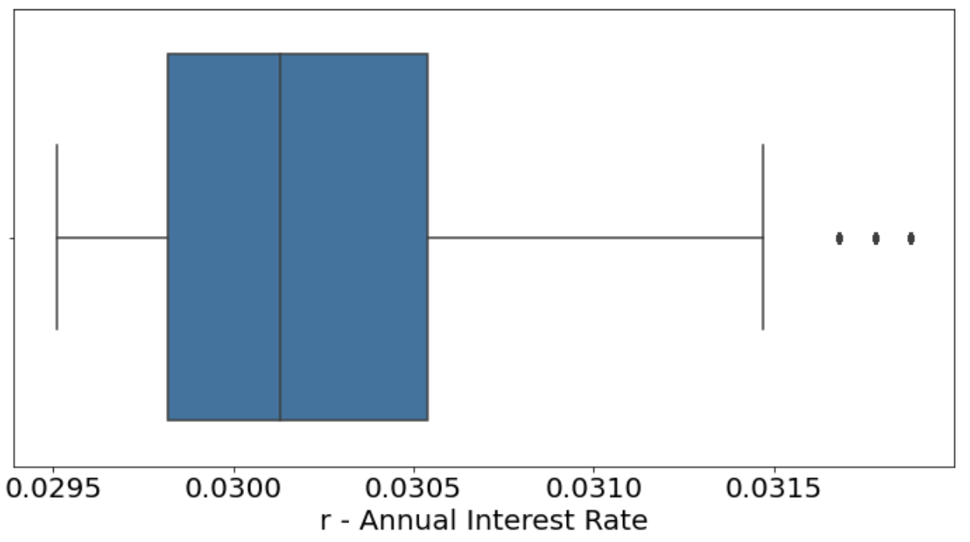
2
Data Exploration & Cleaning
Checking for missings and erroneous
Value (C)
No erroneous data
2 missing values
Use sklearn.impute.SimpleImputer - Mean Imputation
K
No erroneous data
2 missing values
Use sklearn.impute.SimpleImputer - Mean Imputation
r
No erroneous data
No missing values
Notes:
We used histogram and boxplot to see the distribution of records for each column. There is no erroneous in these three columns.
For all the missing value in this dataset, we used mean imputation technique to replace the missing value with the mean value of the entire feature column. A quick way to achieve this is to use the SimpleImputer class from scikit-learn.

Slide 9
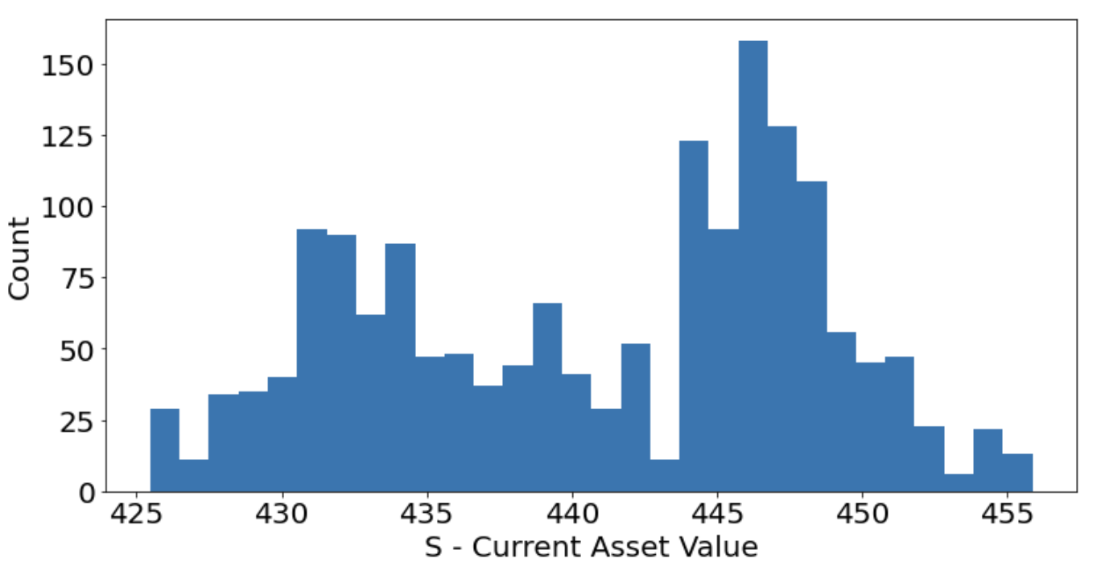
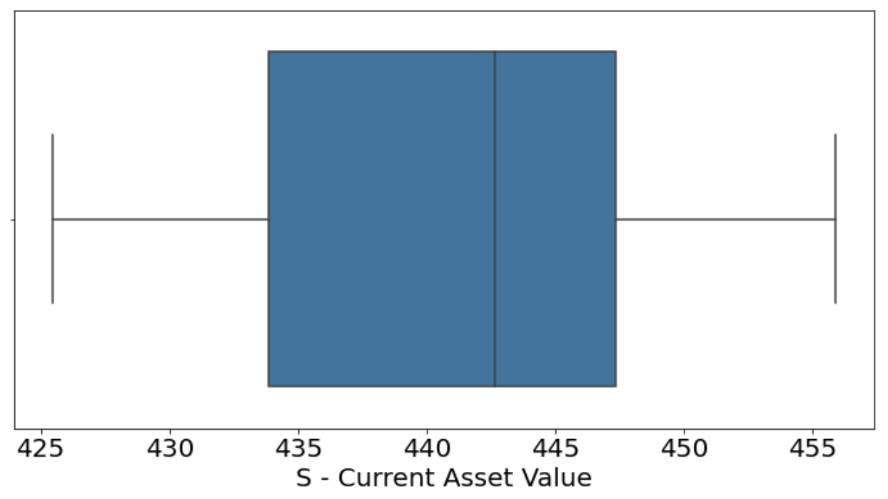
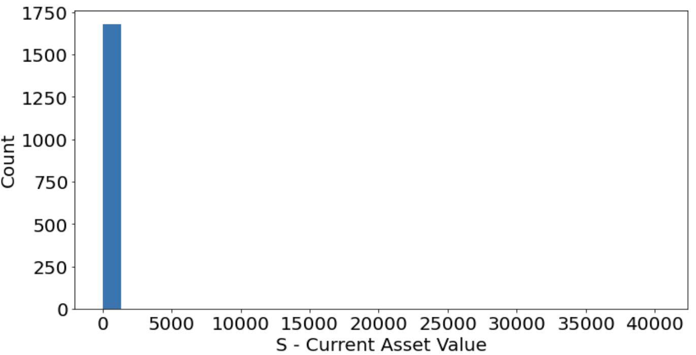
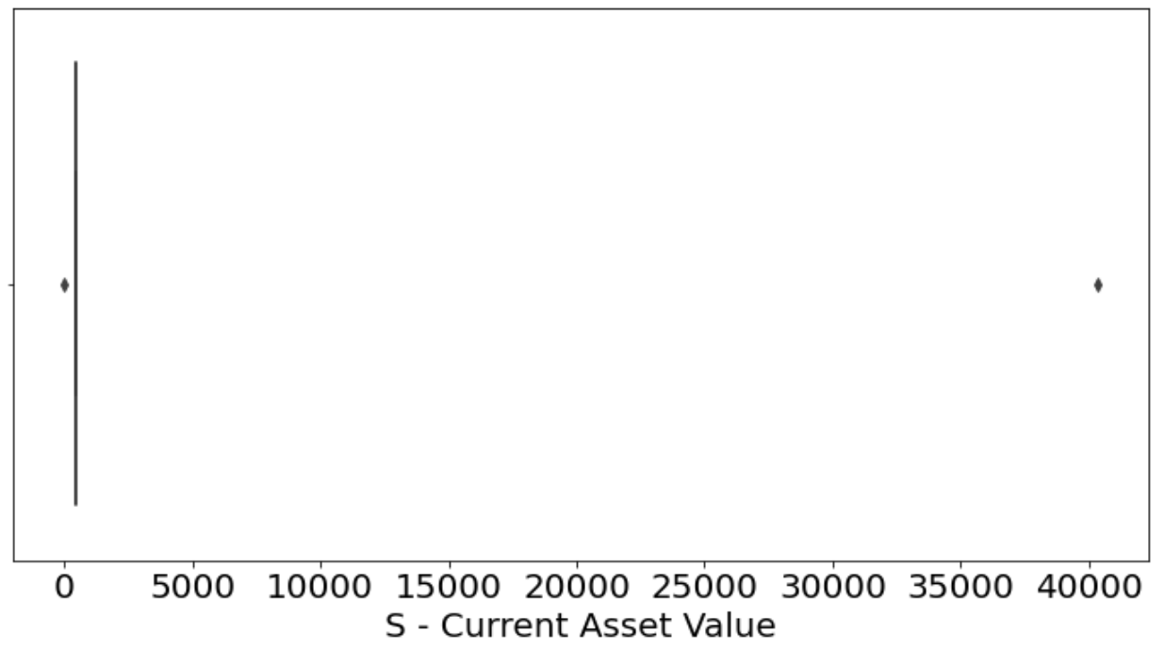
2
Data Exploration & Cleaning
Checking for missings and erroneous
S
Max: 40,333 Min: 0 → Two Erroneous values
1 missing values
Exclude two erroneous values
Use sklearn.impute.SimpleImputer - Mean Imputation
Notes:
For current asset value, column S, the graphs show a weird distribution because of the two outliers. We excluded these two values and fill out the missing value in our dataset to get the new charts like these.

Slide 10
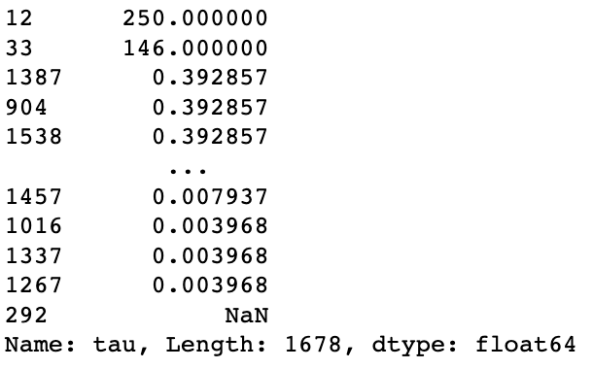
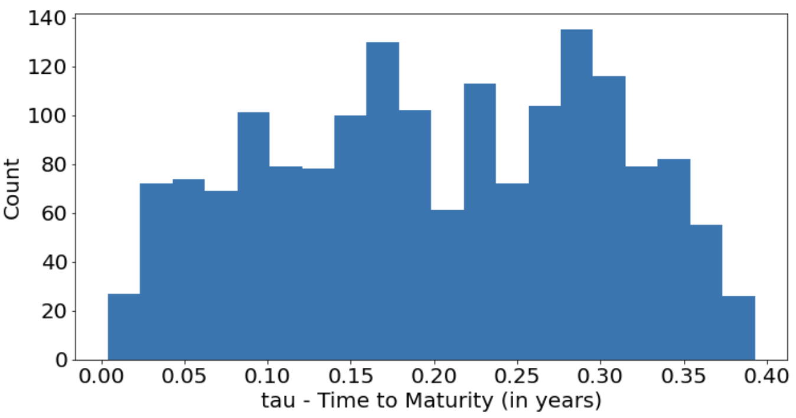
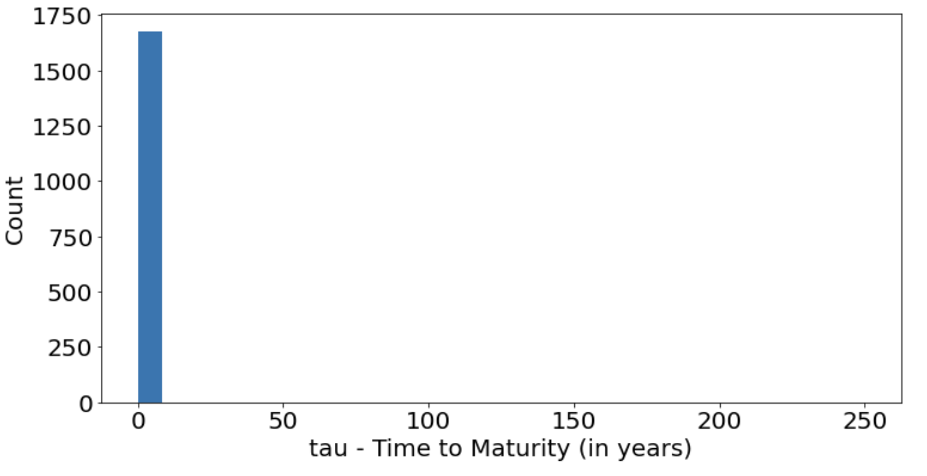
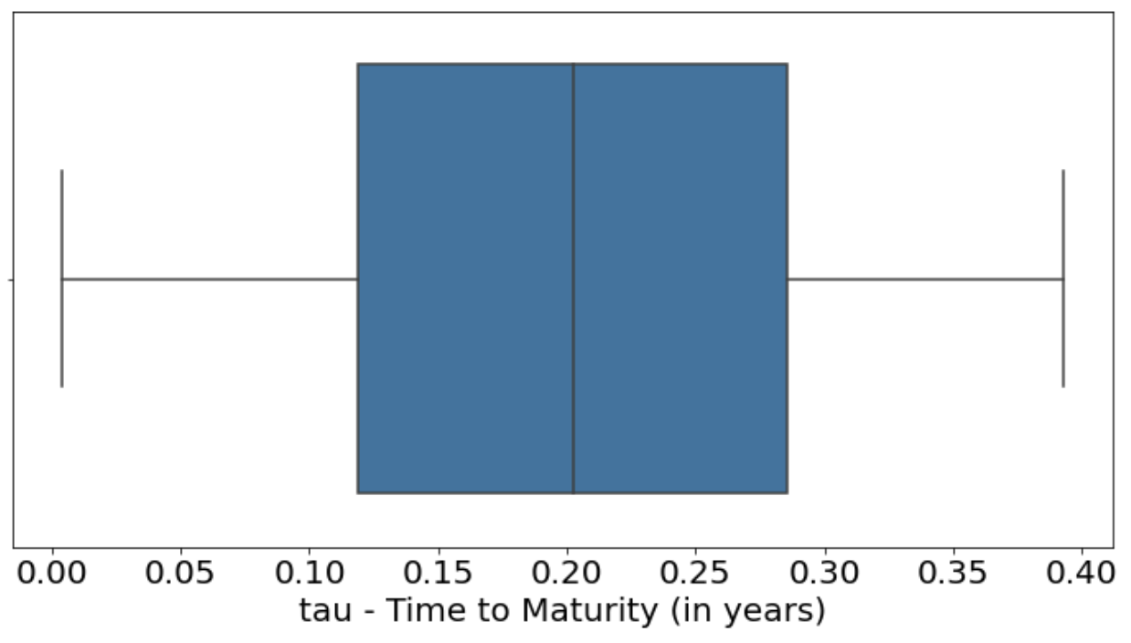
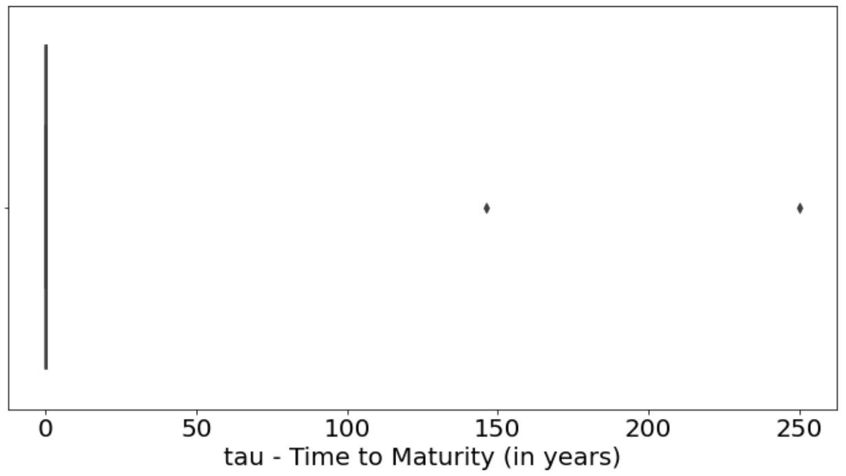
2
Data Exploration & Cleaning
Checking for missings and erroneous
tau
Sort values → Two Erroneous value
1 missing values
Exclude values greater than 1 (year)
Use sklearn.impute.SimpleImputer - Mean Imputation
Notes:
The strange distribution show up again in tau variable. After sorting all the values in this column, we found two entries have value greater than 1 and reach out to hundreds.
It seems not reasonable for the option expiration time in this data if the unit is in years, so we removed these two extremely large data and get the good distribution like these.

Slide 11
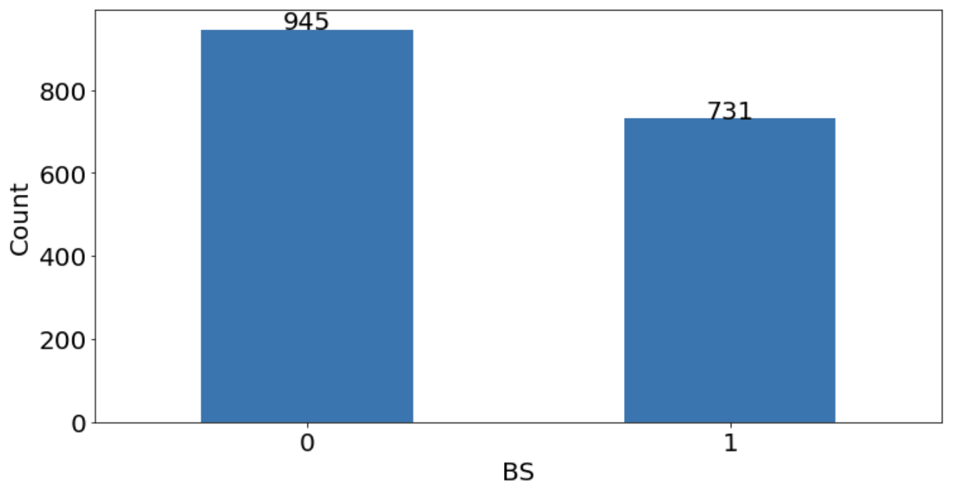
2
Data Exploration & Cleaning
Checking for missings and erroneous
BS
No erroneous data
No missing values
Change “Over” to 1 and “Under” to 0.
There are 945 records show “Under” and 731 records show “Over”
Notes:
The last column, BS, we changed all “under” value to 0 and all “Over” value to 1.

Slide 12
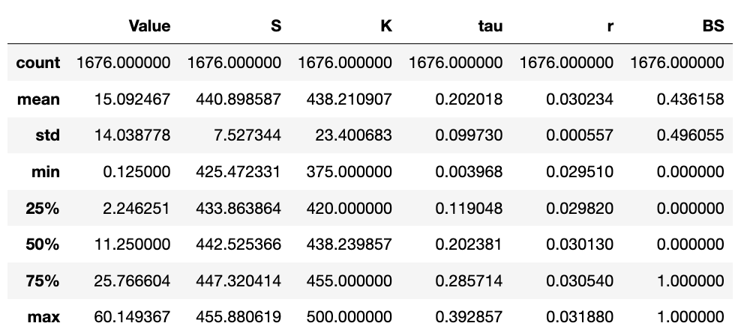
2
Data Exploration & Cleaning
Option_train dataset after exclusion and imputation
There are 1,676 records. All 4 predictors should be included in the prediction.
Use the cleaned option_train dataset to build statistical/ML models with
Value as the response variable (Regression problem)
BS as the response Variable (Classification Problem)
Notes:
OK. After we done for the exclusion and imputation, there are 1676 records remains.
So now let’s use the cleaned option_train dataset to begin our model exploration. I will pass to Angela.
one thousand 6 hundreds and 76

Slide 13
3/6
Model Exploration – Regression
Notes:
Thank you Helen! Now we’ll first talk about regression.

Slide 14
4
Model Exploration – Regression
Linear Regression - MLR
k-Fold Cross-validation
n_splits=10, random_state=2, shuffle=True; scoring = ‘r2’
R-square = 0.91
KNN
Standardized the features before model training
n_neighbors = 5 has a higher R-Square than n_neighbors = 10
R-square = 0.976 < 0.981
Decision Tree
Use ccp_alphas to find the optimal alpha value (hyperparameter) for this model
R-square = 0.992
*Note: All models use 10-fold CV and random_state=2
Notes:
We used 5 different models in our analysis - linear regression, K-nearest neighbors (KNN), decision tree, random forest and XGBoost. For each model, we used cross-validation with k=10 to ensure that our results were reliable.
The baseline model we used was multiple linear regression. We achieved an R-square value of about 0.91, which looks like a good start.
Next, we explored the KNN model, we standardized the features before model training. We explored n_neighbors = 5 and 10. We found that n_neighbors = 5 has a higher R-square value of 0.981.
For the decision tree, To optimize the model, we used cross validation to find the optimal alpha value for complexity parameter. This technique helps us to avoid overfitting. By applying this method, we achieved an R-square value of 0.992. I will pass to Emily to talk about XGBoost.

Slide 15
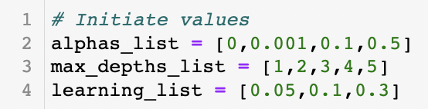
4
Model Exploration – Regression
XGBoost
Use for loop to check training and test score for different combinations of hyperparameters
Hyperparameter Tuning
Objective: Define optimization objective
Learning_rate: Control the speed at which the models learn
max_depth: Details to define a tree
alpha: L1 regularization term
*Note: All models use 10-fold CV and random_state=2
Notes:
Next Slide: For Loop
Thank you, Angela. Next, we will focus on XGBoost. We also split the data for training and testing in an 80/20 ratio. The primary concern is to balance the tradeoff between bias and variance of the model. As the model becomes more complex, bias will decrease, but variance will increase.
To address this issue, we selected three hyperparameters: learning rate, max_depth, and alpha. (The learning rate controls the speed at which the model learns, and a lower learning rate results in a more conservative model. Max_depth determines the level of detail in a tree, and a higher depth will increase variance and cause overfitting as it allows the model to learn on selected training sets). Alpha, the L1 regularization term on weight, helps to reduce model complexity.

Slide 16
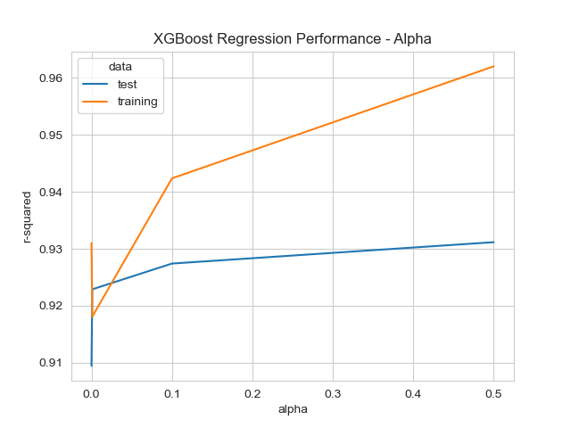
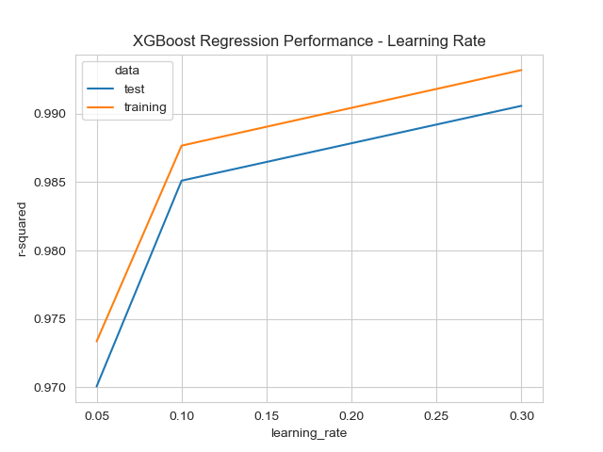
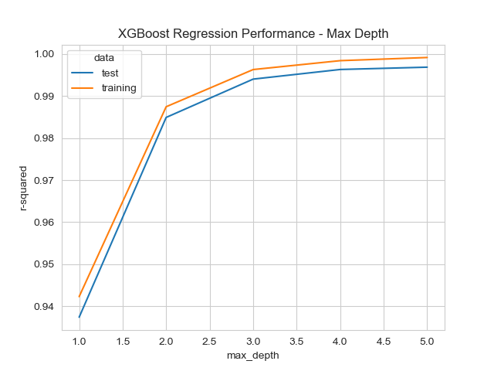
4
Model Exploration – Regression
XGBoost
Overfitting or Underfitting? - No.
The optimal parameters {max_depth=5, reg_alpha=0, learning_rate=0.1}
R-square = 0.997
*Note: All models use 10-fold CV and random_state=2
Notes:
Using a for loop, we calculated both the training and testing r-squared scores for different combinations of hyperparameters to find the optimal solution. The line charts below show the relationships between each hyperparameter and r-squared for the training and test datasets. Based on these charts, we can determine whether our model is overfitting or underfitting by checking the difference between the training and test scores. If the difference increases, we tend to overfit our model. In our combination lists, learning rate and max_depth will not cause overfitting because the difference remains the same as they increase. However, as alpha increases, the model will be overfitting, so we want to keep the alpha small. As a result, we chose hyperparameter max_depth of 5, reg_alpha of 0 and learning_rate of 0.1 and got 0.997 r squared.

Slide 17
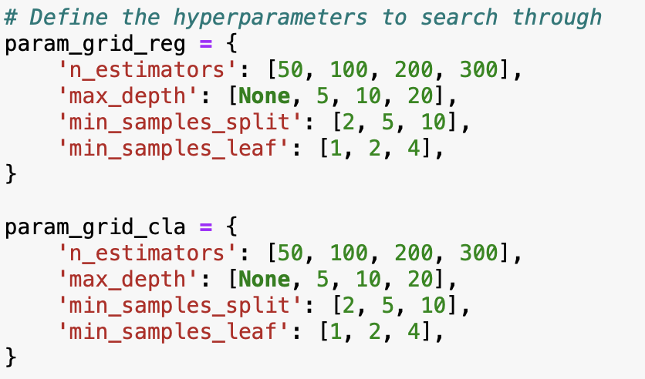
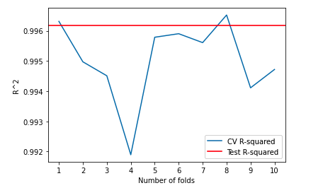
4
Model Exploration – Regression
Random Forest
Use GridSearchCV for hyperparameters tuning to find the optimal set of hyperparameters for the model
Hyperparameter {'max_depth': 20, 'min_samples_leaf': 1, 'min_samples_split': 2, 'n_estimators': 300}
R-square = 0.996
*Note: All models use 10-fold CV and random_state=2
Notes:
The next method that we implemented is random forest, which is an ensemble method. we first split the data into 80% training and 20% as test sets. Then we used GridserchCV, which is a hyper parameter tuning technique. The hyper parameters are defined in the dictionaries, including number of trees, the maximum depth of tree, etc. (minimum number of samples required to split an internal node in the tree, and minimum number of samples required to be at a leaf node), with different values, this function performs an exhaustive search over all possible hyper parameter values and then evaluates the performance using cross validation. After fitting, we obtained the best combination of hyper parameters for the regression model, and this optimized model is then used to make predictions on the test data. We then performed a cross validation with 10 folds using randomForest regressor model.
At the end, We got the avg r-sqaured of 0.996.
Now, I’ll pass to Crystal for the classification models.

Slide 18
4/5
Model Exploration – Classification
Notes:
Thanks Alice

Slide 19
3
Model Exploration – Classification
Logistic Regression
Classification Error = 0.092
Linear Discriminant Analysis (LDA)
Classification Error = 0.088
K-Nearest Neighbors (KNN)
Classification Error = 0.070
n_neighbors = 3
Decision Tree
Classification Error = 0.077
*Note: All models use 10-fold CV and random_state=2
Notes:
For classification problem, we have performed the following models, however, their performance are not satisfactory, and we explored 2 additional models.

Slide 20
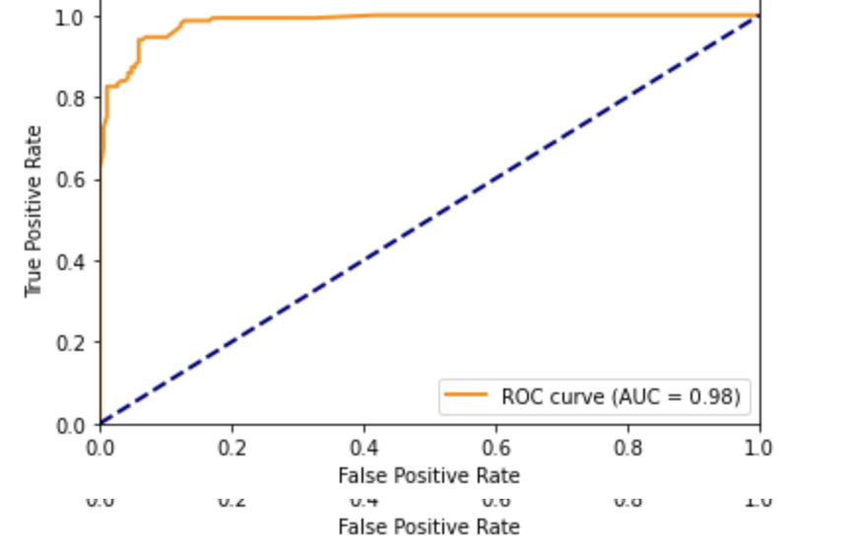
3
Model Exploration – Classification
Random Forest
Use GridSearchCV to find the optimal set of hyperparameters for the model
Hyperparameter {'max_depth': None, 'min_samples_leaf': 1, 'min_samples_split': 2, 'n_estimators': 100}
Classification Error = 0.068
*Note: All models use 10-fold CV and random_state=2
Notes:
As you can see, our Random Forest model with the chosen parameters has a smaller classification error of 0.068

Slide 21
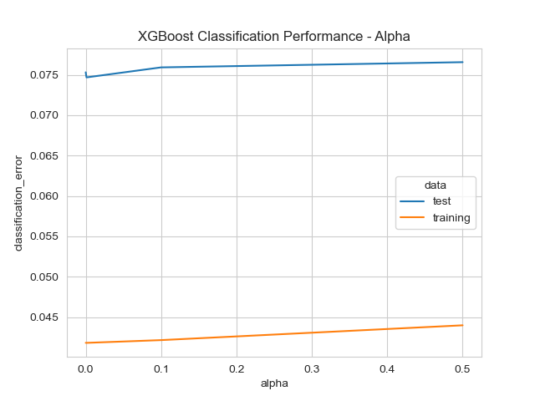
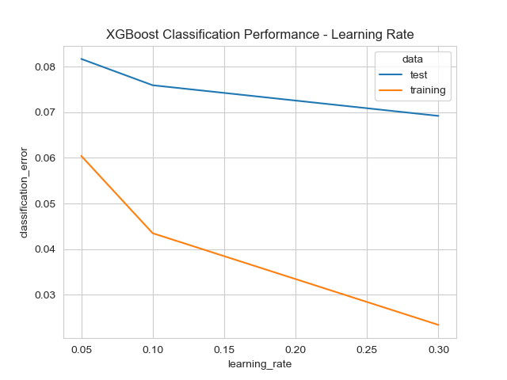
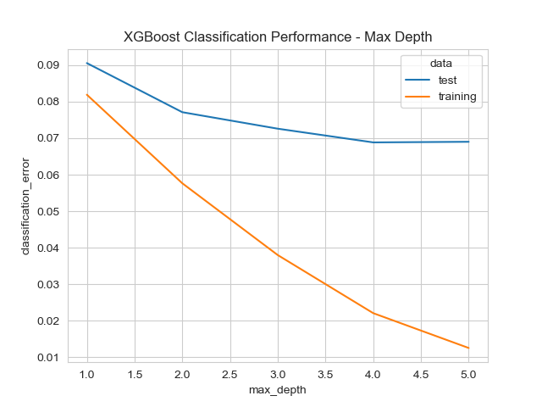
3
Model Exploration – Classification
XGBoost
Overfitting or Underfitting? No.
The optimal hyperparameters {max_depth=2, reg_alpha=0.001, learning_rate=0.3}
Classification error = 0.072
as max_depth increase, model will overfit
*Note: All models use 10-fold CV and random_state=2
Notes:
For XGBoost, As indicated by the line chart, alpha did not have a substantial effect on model performance,
while the other two parameters resulted in overfitting if they were set to larger values.
To ensure that our test score met the required 8%, we chose a depth of 2 and a learning rate of 3,
which would not cause the model to overfit. The classification error is 0.072.(point zero seven two)

Slide 22
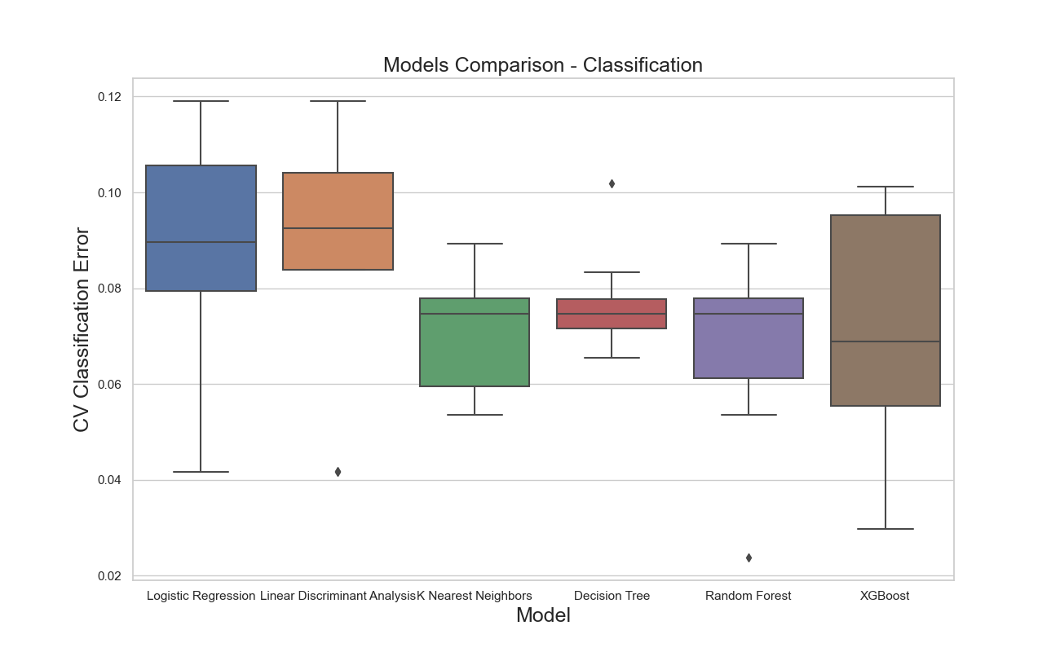
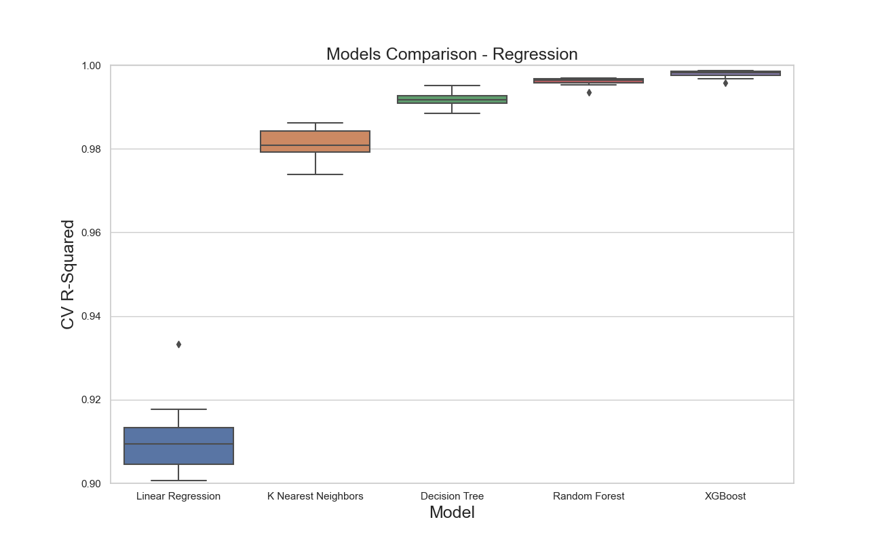
3
Model Comparison – Regression & Classification
As you can see the chart show above, Random Forest model has a better performance compared with others
*Note: All models use 10-fold CV and random_state=2
Notes:
Here shows the performance of all models.
we can see Random Forest has the most robust performance.

Slide 23
5/5
Conclusion

Slide 24
5
Conclusion
Final Model
Random Forest is chosen for classification and regression problem
We use Random Forest model to make prediction for Value (C) and BS on the 1,120 options in the test dataset.
NOT using our train model to predict option values for Tesla stocks
Option values are influenced by a variety of factors, such as industry trends, economic conditions or company-specific news
Elon Musk has a strong influence on the company’s stock price and investor sentiment towards the company
Notes:
In conclusion, Random Forest is our final model for both classification and regression problem.
We use it to make prediction for Value (C) and BS on the test dataset.
Although random forest model has a robust performance,
we will not use this model to predict option values,especially for stocks with high volatility like Tesla,
For instance , Elon Musk has a strong impact on the company’s stock price whenever he tweet on twitters.
There’re other uncertainties as well.
It is end of our presentation, thank you for listening.

